Slide 1
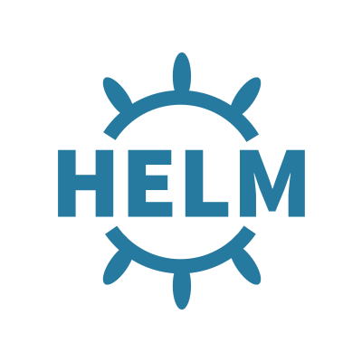
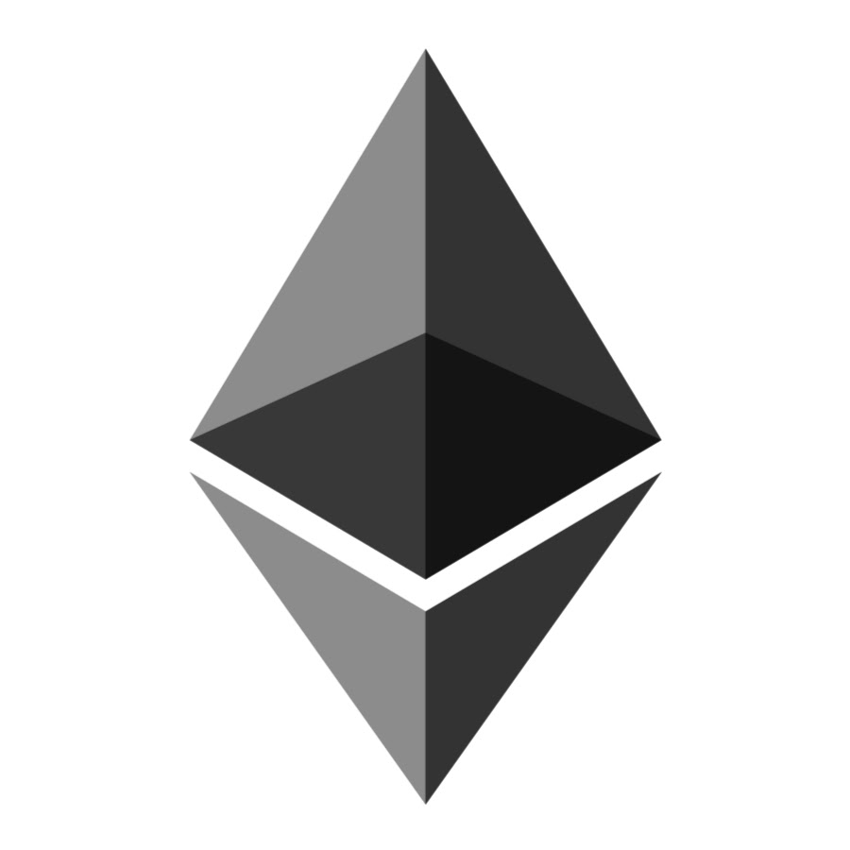
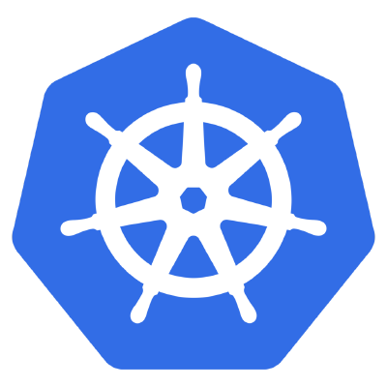
Using to Deploy to
(Helm)
(Ethereum)
(Kubernetes)
Vancouver k8s Meetup
March 2018
Jason Poon Senior Software Engineer @ Microsoft
Notes:
Poll
Agenda
Intro

Slide 2
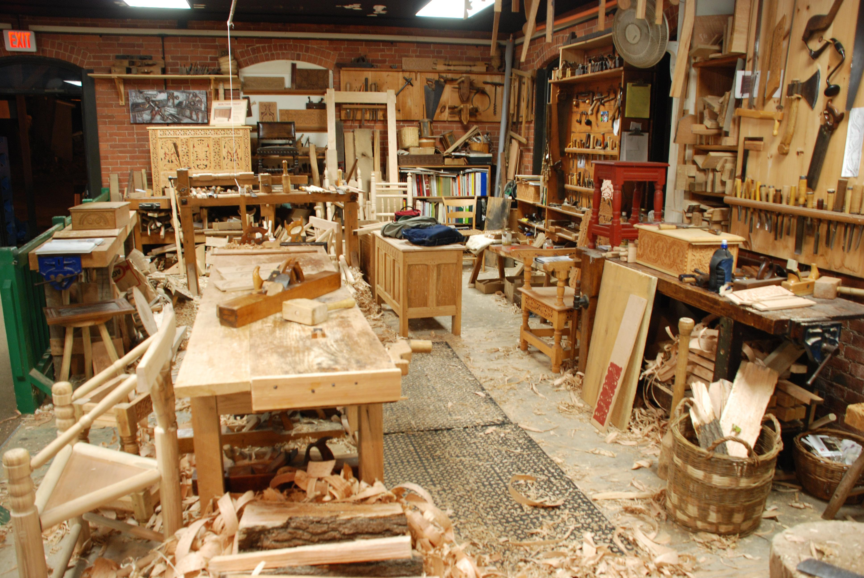
Kubernetes provides you the tools to build your furniture from scratch
http://woodworkingbluepritns.com
Notes:
Workshop has lots of tools
Tools that allow you to do lots of things. For example, in this workshop, you could build a basic table
Or create something magnificient and intricant and grant and beautiful and detailed
With the resource manifests and kubectl, we have all the tools we need to create Kubernetes native resources from scratch.

Slide 3
Most of us don’t want to build from scratch

Slide 4


Slide 5
We need a tool to manage a group of resources as one unit.
Notes:
We found ourselves as IKEA people more so. The assemblers. Didn’t really want to build things from scratch ourselves. What we needed to do that in kubernetes was create a way to manage a group of resources as one unit.

Slide 6

The Kubernetes Package Manager
Notes:
Wordpress on k8s dont have to build it
Don’t have to start from the ground floor when trying to run mysql
Don’t even have to figure out how to run jenkins from k8s from scratch
Giving all of us the ability to do 2 things

Slide 7
Package Manager
Deployment Manager
Bundle primitives into a single logical deployment unit: Chart
Consist of...
Metadata
Kubernetes resource definitions
Documentation
Charts == Helm Package
Repeatable deployment
Dependency Management
Update, rollback, and test application deployments
Release == Instance of chart running in cluster

Slide 8
Workflow
Notes:
in-cluster component
Lives his life inside k8s as a pod
helps manage releases in your cluster
Release = installation of a Kubernetes Chart
Helm is the command line tool that talks to tiller to install charts into the cluster.

Slide 9
Getting Started
Install
MacOS: brew install kubernetes-helm
Windows: choco install kubernetes-helm
Linux: Download from github.com/kubernetes/helm/releases

Slide 10
Demos
Init
Install a Chart
Upgrade a Release
Delete a Release

Slide 11
Your First Chart
$ helm create myapp
Notes:
How do you build your own chart?
Get started easily with helm create

Slide 12
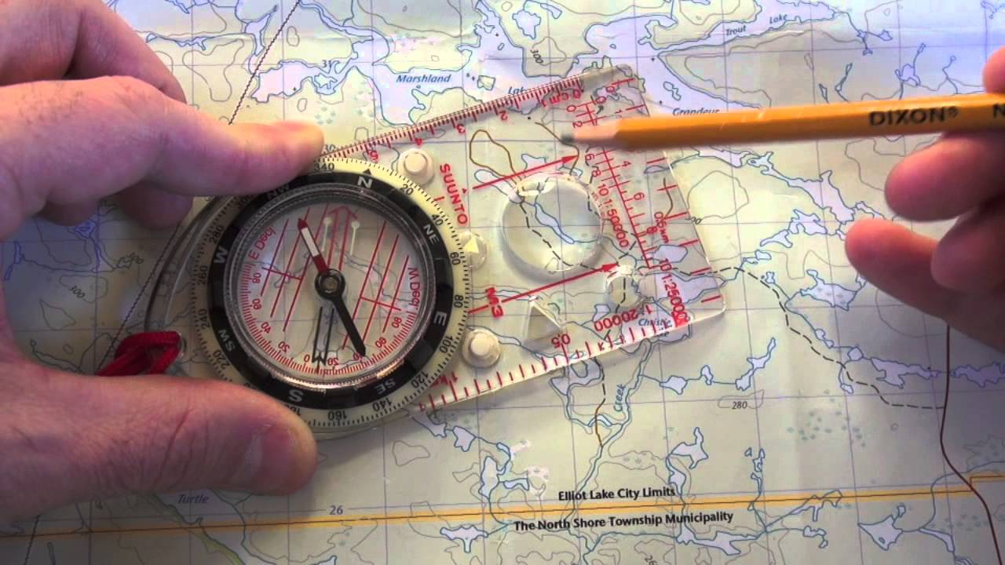
Navigating a Chart
myapp
├── Chart.yaml
├── README.md
├── charts
├── templates
├── values.yaml
└── requirements.yaml
Notes:
How do you build your own chart?
Get started easily with helm create

Slide 13
Templates
myapp
├── Chart.yaml
├── README.md
├── charts
├── templates
├── deployment.yaml
└── svc.yaml
├── values.yaml
└── requirements.yaml
Notes:
How do you build your own chart?
Get started easily with helm create

Slide 14
Configuration
values.yaml
image: mycompany/myapp:1.0.0
imagePullPolicy: IfNotPresent
service:
port: 80
myapp
├── Chart.yaml
├── README.md
├── charts
├── templates
├── deployment.yaml
└── svc.yaml
├── values.yaml
└── requirements.yaml
templates/deployment.yaml
apiVersion: extensions/v1beta1
kind: Deployment
spec:
template:
spec:
containers:
- name: {{ .Chart.Name }}
image: "{{ .Values.image }}"
imagePullPolicy: {{ .Values.imagePullPolicy }}
ports:
- containerPort: {{ .Values.service.port }}
Notes:
How do you build your own chart?
Get started easily with helm create

Slide 15
Configuration
values.yaml
image: mycompany/myapp:1.0.0
imagePullPolicy: IfNotPresent
service:
port: 80
Configure values on command line with the --set flag
$ helm install --set service.port=8080 myapp/
Or pass in a new values file on command line with the -f flag
$ helm install -f myvalues.yaml myapp
Notes:
How do you build your own chart?
Get started easily with helm create

Slide 16
Dependencies
requirements.yaml
dependencies: - name: mariadb version: 0.5.2 repository: http://storage.googleapis.com/kubernetes-charts
myapp
├── Chart.yaml
├── README.md
├── charts
├── templates
├── values.yaml
└── requirements.yaml
Notes:
As you package your app as a chart, you may find you need a dependency or two
For example, MariaDB is a dependency of a WordPress chart
The 'charts' directory lets you vendor in charts as dependencies/sub-charts
Use requirements.yaml file to manage pulling in dependencies from hosted repositories

Slide 17
Documentation
myapp
├── Chart.yaml
├── README.md
├── charts
├── templates
└── NOTES.txt
└── values.yaml
Notes:
Readme
Generally the first thing people will look at
Describe what the chart is, prerequisites
Detail out configuration options and defaults
Explain how to install/upgrade and delete the chart
NOTES.txt
Gets printed out after install/upgrade and checking the status of a release
Great place for explaining post-install steps/quickstart
Templated so can provide working commands to copy and paste (if templating service name, etc.)
Popular charts tend to have a really good and detailed Notes section

Slide 18
Metadata
myapp
├── Chart.yaml
├── README.md
├── charts
├── templates
├── values.yaml
└── requirements.yaml
Notes:
General metadata about the chart: name, description, sources, maintainers
Also contains the semantic version for the chart
Not necessarily same as app being packaged
Can be used to describe breaking changes in the chart
Keywords are searchable

Slide 19

Webjet’s Road to Helm
Templatize and easily configure their deployments for use across different environments
Stable distributions of the application that can be shared to other dependent teams
‘Push Button’ Deploy
Notes:
Build your own charts, and easily share them
By capturing a chart as a package, you have a stable distribution that can be installed repeatedly with the same result.
Manage application lifecycle over time
Our programs change. Our configuration changes. So any tool designed to manage Kubernetes applications must make it easy to reconfigure, update, delete, and learn about the lifecycle of your app
Fit releases to your existing tools and process (not vice versa)
Helm is designed to fit the paradigm of existing package management tools like yum and apt-get, and designed to integrate with CI/CD pipelines in a flexible way
Let the cluster be the collaborative center for your releases
https://platform9.com/blog/kubernetes-helm-why-it-matters/

Slide 20
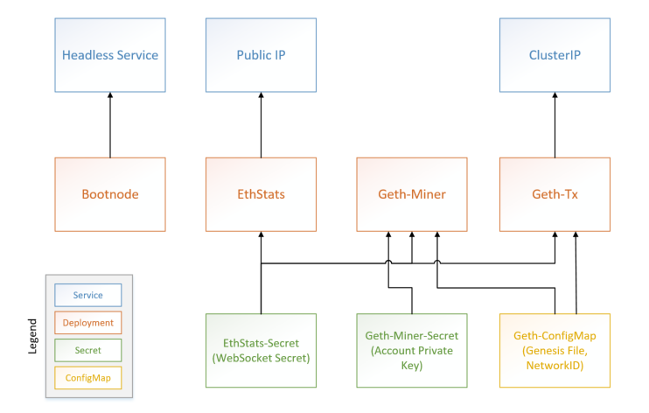
Ethereum

Slide 21

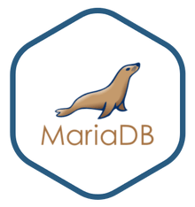



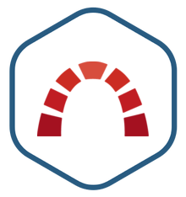
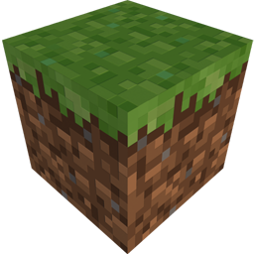
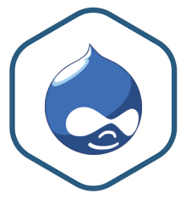
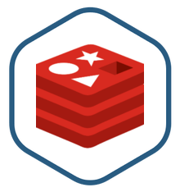

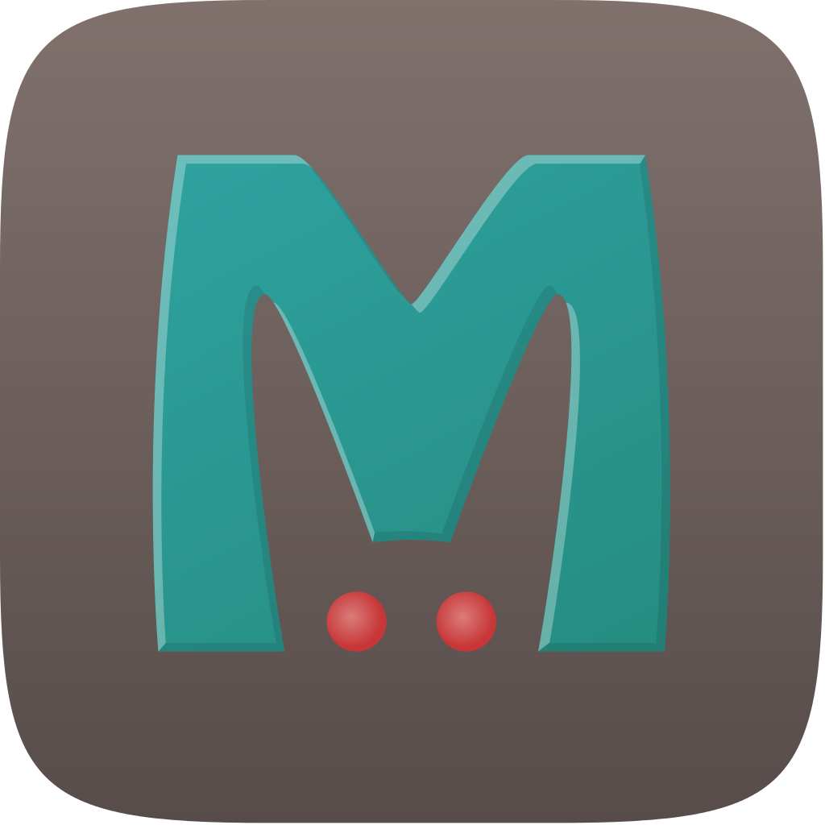

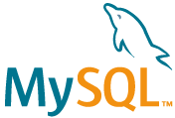

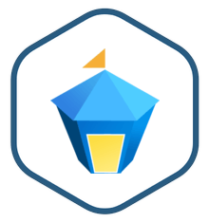
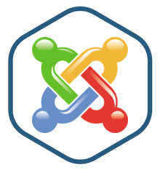
Official Charts Repository
Curated, ready-to-run applications
github.com/kubernetes/charts
KubeApps.com

Slide 22
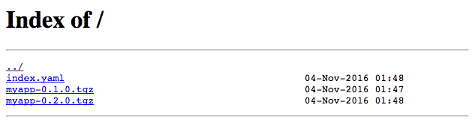
Chart repositories
Has an index.yaml file
Any web server accessible via http(s)
$ helm repo add mycompany charts.mycompany.com
$ helm install mycompany/myapp

Slide 23

Chart Best Practices
Charts are…
Self-Contained
Modularized
Reusable
Reproducible
Configurable
Notes:
self-contained
A chart is a whole application bundle, it includes all the dependencies required for running the application in your cluster.
It is self-sufficient, works out of the box.
Each release of a Chart should be self-contained, and I should be able to deploy multiple independent instances of my charts
modularized
Each Chart should be responsible for deploying one component
Split components into different sub-charts and pull them in as dependencies
reusable
Charts should try to be reusable so that other Charts can build off of them. The classic example is a database chart could be run independently, or pulled into another chart to run an application - it should support both workflows.
Parts of the Chart can be reusable, use the templating engine to render partials or template functions to reduce duplication in your manifests.
reproducible
Charts are packaged and bundled with all dependencies to provide an immutable deployment. This can be furthered by ensuring your Chart pulls in immutable image tags/content shas.
When sharing Charts, it should be possible to deterministically reproduce deployments.
Bumping declarative model up: no shell scripts, templates are declarative
This makes rollbacks easy, keeps history
configurable
Any configuration should be decoupled from the manifests and provided using the values.yaml file.
Examples include: Docker images and tags, application configuration, secrets, config map configuration
Secure defaults should be used where possible

Slide 24



Resources
Helm Docs https://docs.helm.sh/using_helm/
Helm Charts Repo https://github.com/kubernetes/charts
Helm Core https://github.com/kubernetes/helm
KubeApps https://kubeapps.com/
Using Helm to Deploy Blockchain to Kubernetes www.microsoft.com/developerblog/2018/02/09/using-helm-deploy-blockchain-kubernetes/
Slides Inspired from (with permission): Taking the Helm: Delivering Kubernetes-Native Applications https://cnkc16.sched.com/event/8K95/taking-the-helm-delivering-kubernetes-native-applications-michelle-noorali-and-matt-butcher-deis-adnan-abdulhussein-bitnami
Jason Poon github.com/jpoon
@jasonthepoon
jason.poon@microsoft.com

